Slide 1
Relational Integrity constraints or RULES

Slide 2
Concept of Null or Unknown Value
Null represent a value for an attribute that is currently unknown or it Is not applicable for this tuple.
Null is not same as 0 or zero value or a text string.
It represent absence of value
At a particular time the following table might not have the value of age (of Rajesh) and Job (of Raja)
Name | Age | Job
Rajesh | - | Clerk
Raja | 23 | -
Amit | 43 | Sales

Slide 3
Difference between Null and Not Applicable
Blank against Amit might indicate that pension is not applicable to this employee as per firm policy.
Name | Age | Job | Pension_Date
Rajesh | - | Clerk | -
Raja | 23 | - | 01/01/1999
Amit | 43 | Sales | -
Best way to represent it as :
Name | Age | Job | Pension_Date
Rajesh | null | Clerk | null
Raja | 23 | null | 01/01/1999
Amit | 43 | Sales | Not Applicable

Slide 4
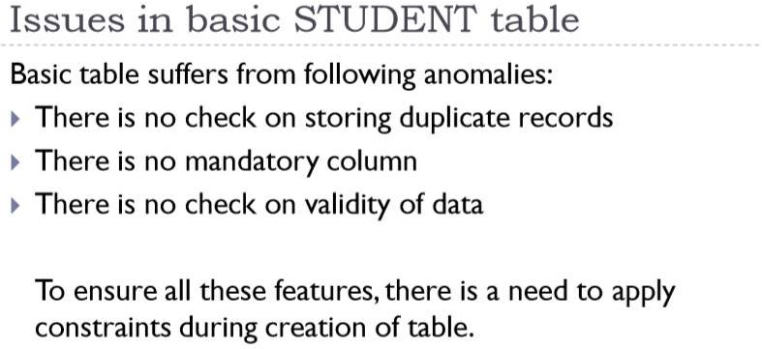

Slide 5
Relational Integrity constraints/RULES
Relational Integrity constraints is referred to conditions which must be present for a valid relation. These integrity constraints are derived from the rules that the database represents.
There are many types of integrity constraints. Constraints on the Relational database
management system is mostly divided into three main categories are:
Domain constraints
Entity integrity or Key/primary key constraints
Referential integrity constraints

Slide 6
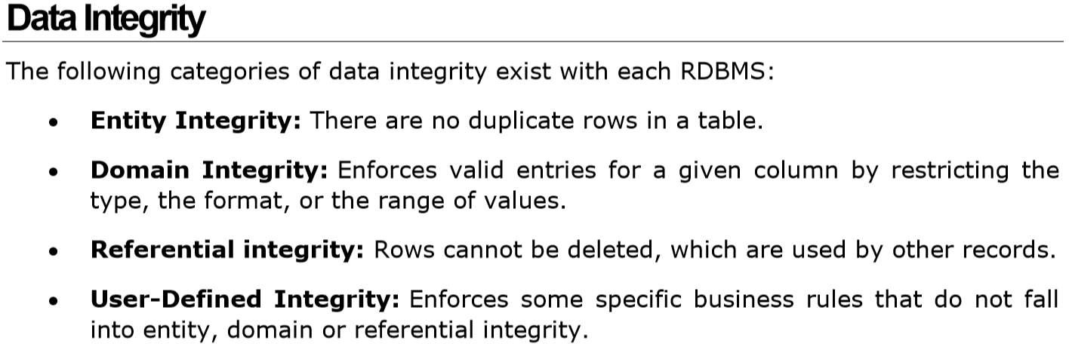
Relational Integrity constraints or RULES

Slide 7
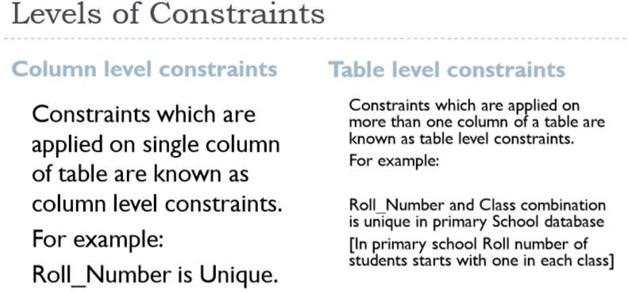

Slide 8
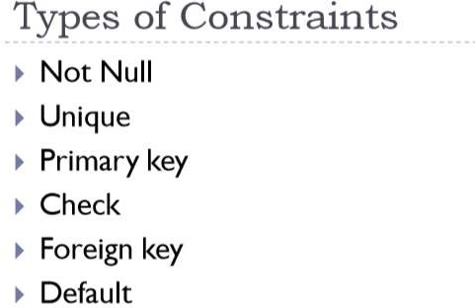

Slide 9
NOT NULL Constraint
By default, a column can hold NULL values.
If you do not want a column to have a NULL value, then you
need to define such a
constraint on this column specifying
that NULL is now not allowed for that column.
A NULL is not the same as no data, rather, it represents unknown data.

Slide 10
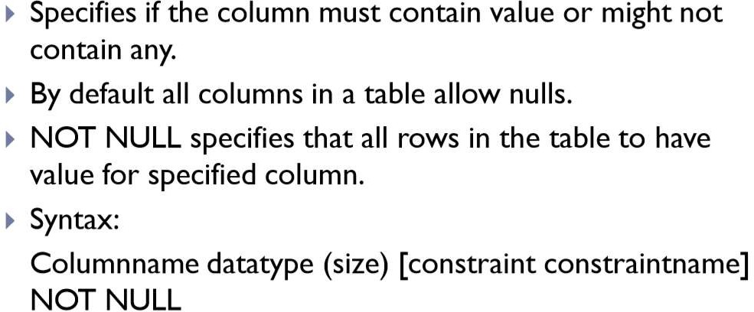
NOT NULL Constraint

Slide 11
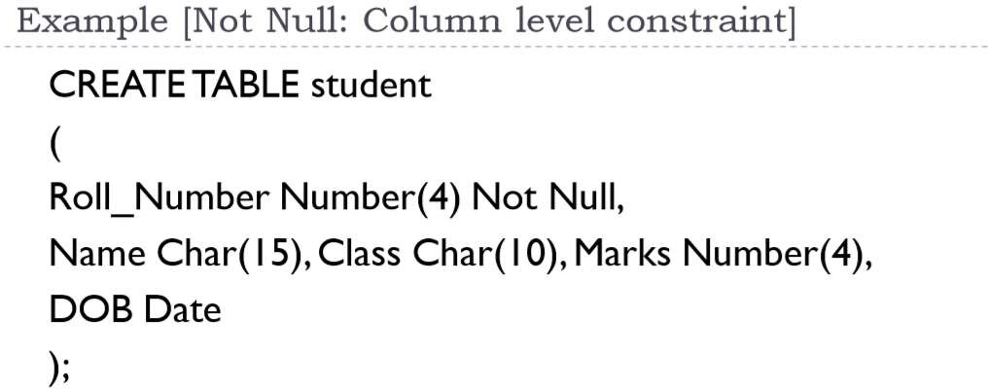

Slide 12
Example
CREATE TABLE CUSTOMERS( ID INT
NOT NULL, NOT NULL, NOT NULL,
NAME VARCHAR (20) AGE INT
ADDRESS CHAR (25) , SALARY DECIMAL (18, 2), PRIMARY KEY (ID)
);
If CUSTOMERS table has already been created, then to add a NOT NULL constraint
to the SALARY column in
ALTER TABLE CUSTOMERS MODIFY SALARY DECIMAL (18, 2) NOT NULL;

Slide 13
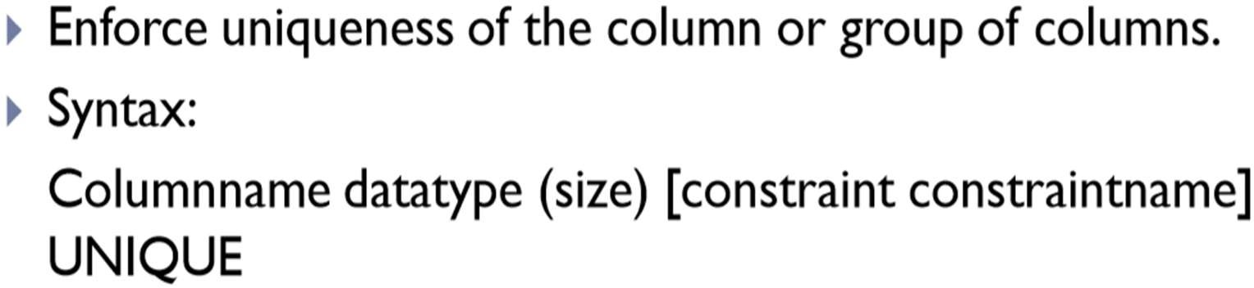
UNIQUE Constraint
The UNIQUE Constraint prevents two records from having identical values in a column.
E.g. In the CUSTOMERS table, for example, you might want to prevent two or more people from having an identical age.

Slide 14
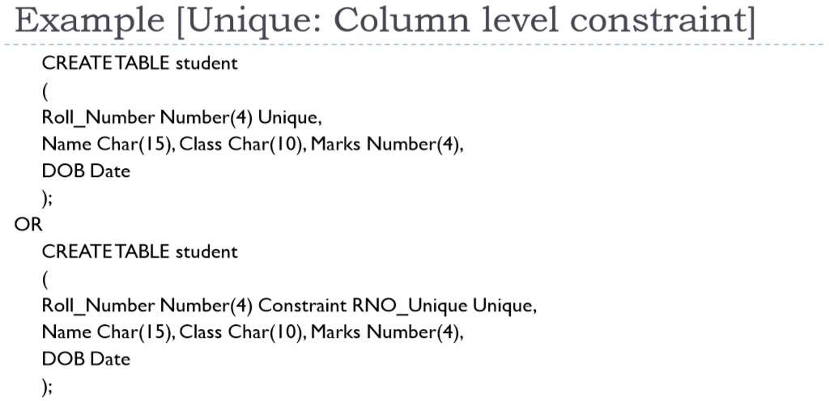

Slide 15
Example
For example, the following SQL query creates a new table called CUSTOMERS and adds five columns.
Here, the AGE column is set to UNIQUE, so that you cannot have two records with the
same age.
CREATE TABLE CUSTOMERS( ID INT NOT NULL,
NAME VARCHAR (20) NOT NULL,
AGE INT NOT NULL UNIQUE,
ADDRESS CHAR (25) , SALARY DECIMAL (18, 2), PRIMARY KEY (ID)
);

Slide 16
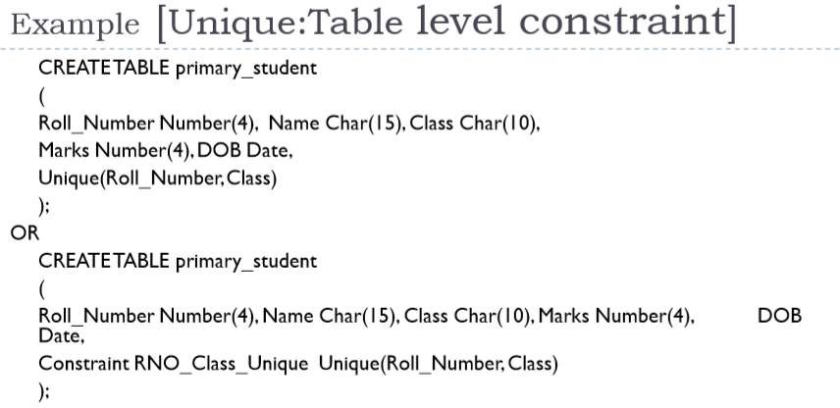

Slide 17
Adding Constraint
ALTER TABLE CUSTOMERS
ADD CONSTRAINT myUniqueConstraint UNIQUE(AGE, SALARY);
DROP a UNIQUE Constraint
To drop a UNIQUE constraint, use the following SQL query.
ALTER TABLE CUSTOMERS
DROP CONSTRAINT myUniqueConstraint;

Slide 18
Entity Integrity OR Key/Primary Key constraints
An attribute that can uniquely identify a tuple in a relation is called the key of the
table.
The value of the attribute for different tuples in the relation has to be unique.
Entity integrity constraints are rules for primary keys:
The primary key cannot have a null value.
If the primary key is a composite key, none of the fields in the key can contain a null value.

Slide 19
Entity Integrity OR Key/Primary Key constraints
Example:
In the given table, CustomerID is a key attribute of Customer Table.
It is most likely to have a single key for one customer, CustomerID =1 is only for the CustomerName =" Google".
CustomerID | CustomerName | Status
1 | Google | Active
2 | Amazon | Active
3 | Apple | Inactive

Slide 20
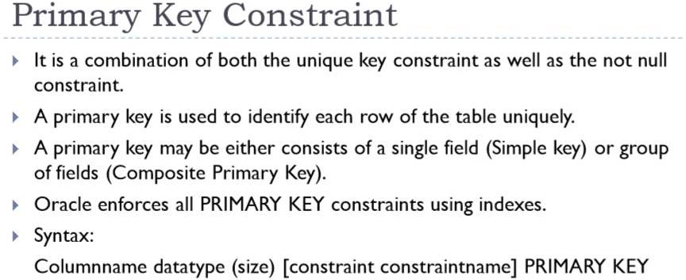

Slide 21
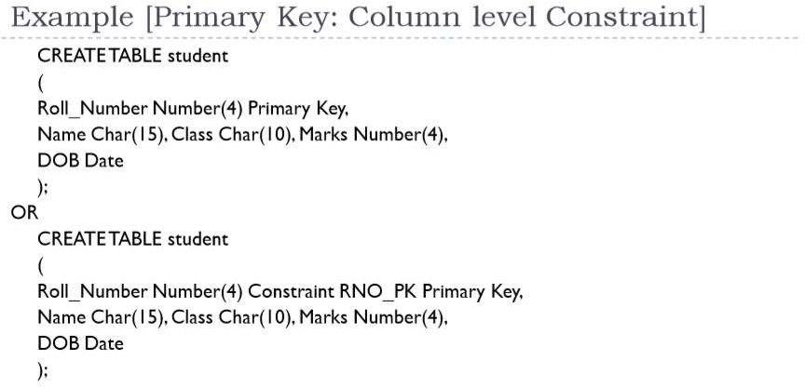

Slide 22
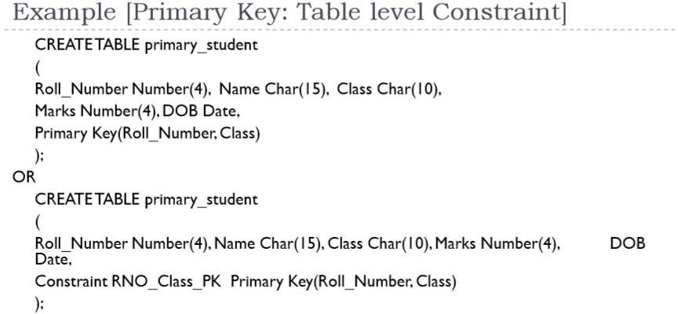

Slide 23
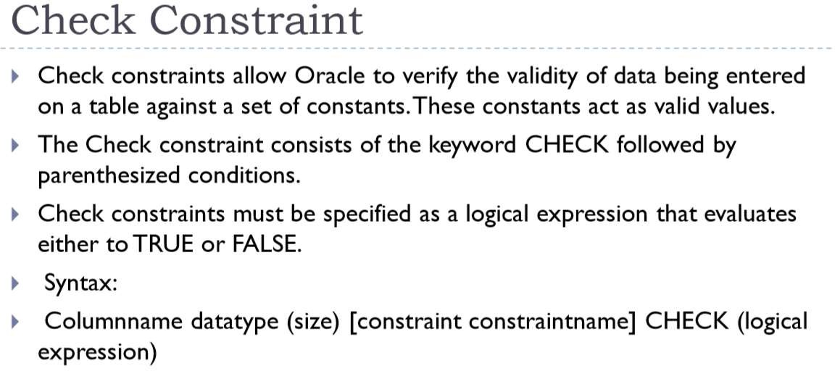

Slide 24
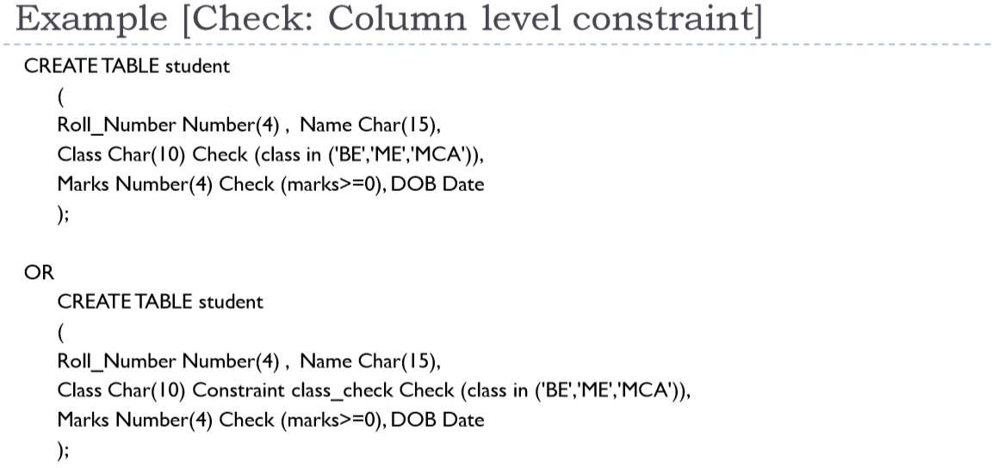

Slide 25
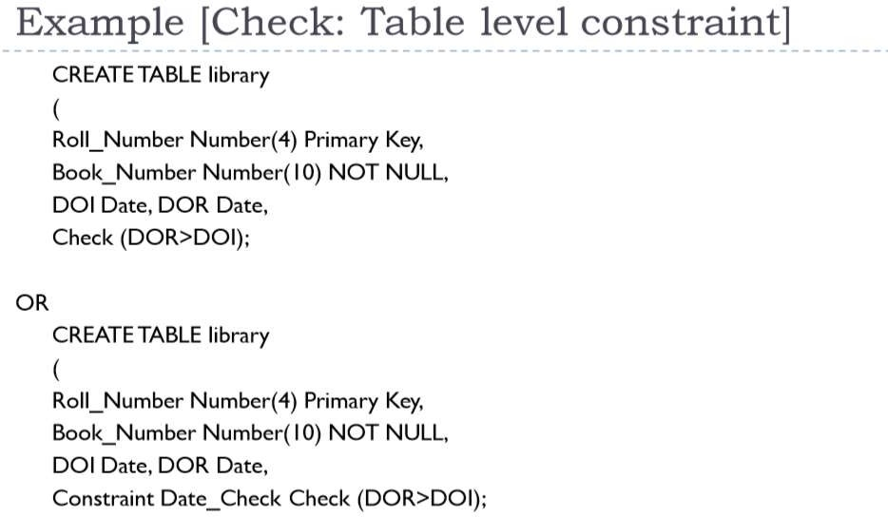

Slide 26
Example
For example, the following program creates a new table called CUSTOMERS and adds five columns. Here, we add a CHECK with AGE column, so that you cannot have any CUSTOMER who is below 18 years.
CREATE TABLE CUSTOMERS( ID INT NOT NULL,
NAME VARCHAR (20) NOT NULL,
AGE INT NOT NULL CHECK (AGE >= 18),
ADDRESS CHAR (25) , SALARY DECIMAL (18, 2), PRIMARY KEY (ID)
);

Slide 27
If the CUSTOMERS table has already been created, then to add a CHECK constraint to AGE column, you would write a statement like the one given below.
ALTER TABLE CUSTOMERS
MODIFY AGE INT NOT NULL CHECK (AGE >= 18 );
Or
ALTER TABLE CUSTOMERS
ADD CONSTRAINT myCheckConstraint CHECK(AGE >= 18);
DROP a CHECK Constraint
ALTER TABLE CUSTOMERS
DROP CONSTRAINT myCheckConstraint;

Slide 28
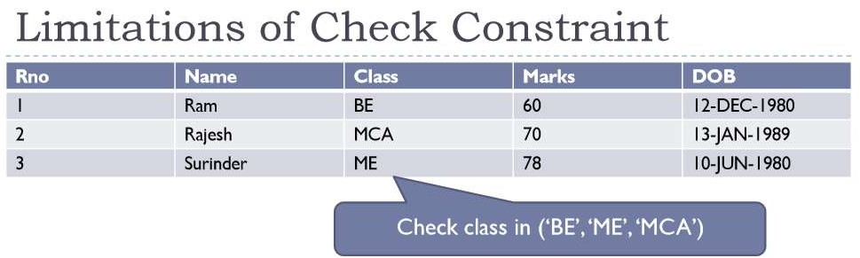

Slide 29
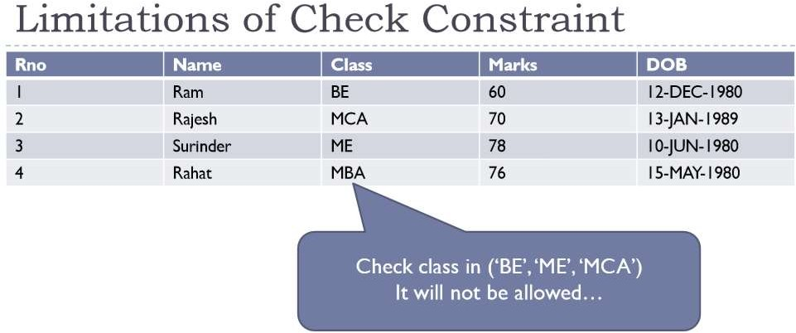

Slide 30
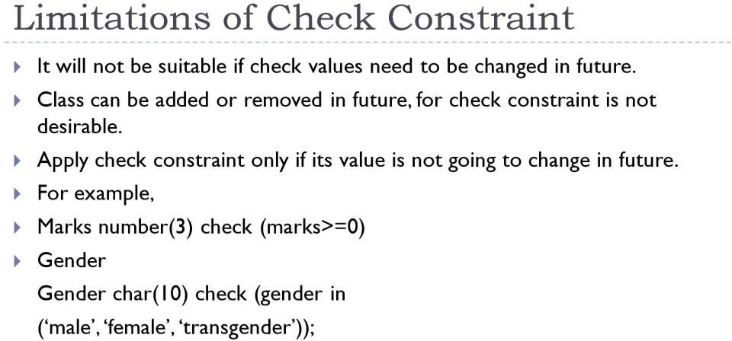

Slide 31
Referential integrity constraints
Referential integrity constraints is base on the concept of Foreign Keys.
A foreign key is an important attribute of a relation which should be referred to in other relationships.
Referential integrity constraint
state happens where relation refers to a key attribute
of a different or same relation.
However, that
key element must exist in the table.

Slide 32
Referential Integrity
Referential Integrity can help to
avoid data input errors, voids data inconsistency and
quality problems.
In a relational database, referential integrity means that a foreign key value cannot be entered in one table unless it matches an existing primary key in another table.
➢
You cannot change a primary key that has matching child table records
➢
A child table that has a foreign key for a different record
Referential integrity also
can prevent the deletion of a record has a primary key that
matches foreign keys in another table.

Slide 33
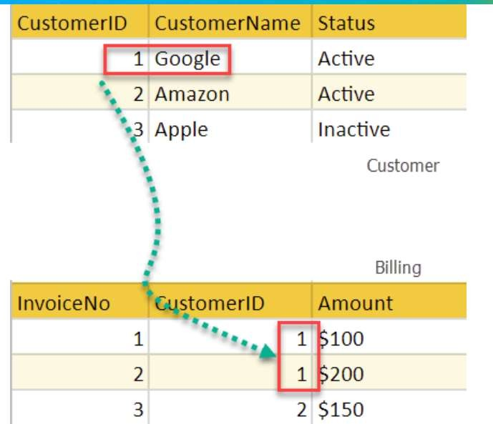
In the above example, we have 2 relations, Customer and Billing.
Tuple for CustomerID =1 is referenced twice in the relation Billing. So we know CustomerName=Google has billing amount $300

Slide 34
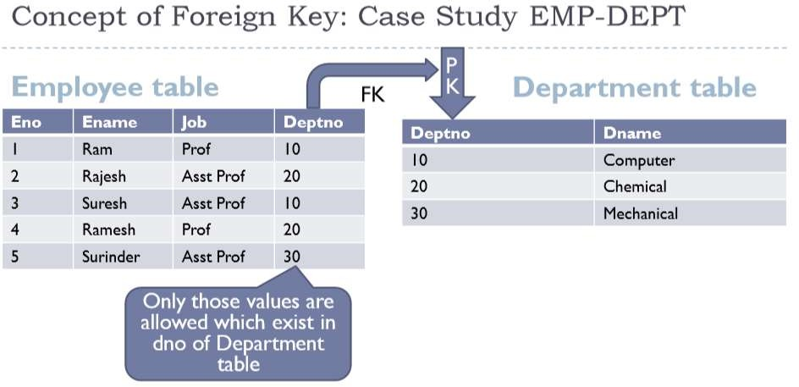

Slide 35
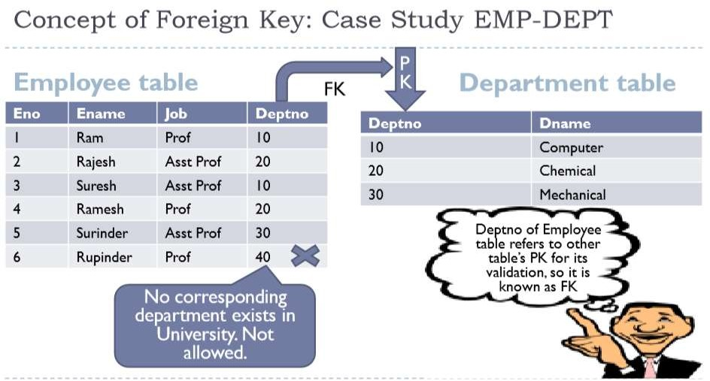

Slide 36
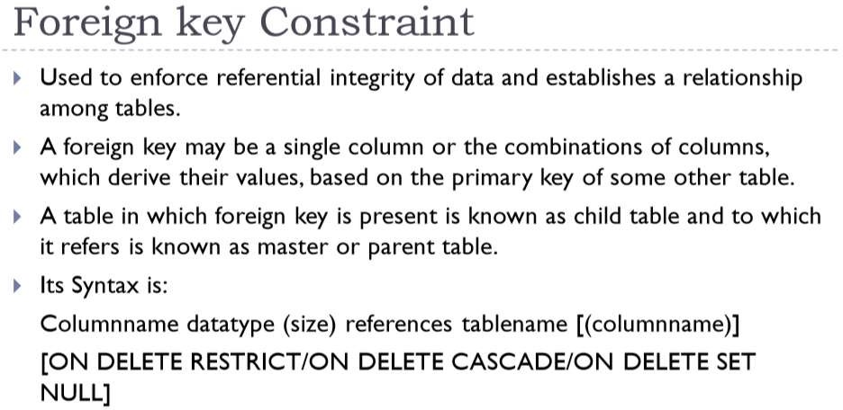

Slide 37
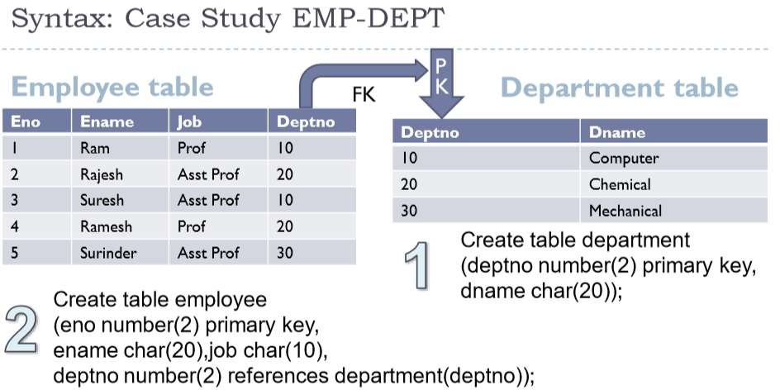

Slide 38
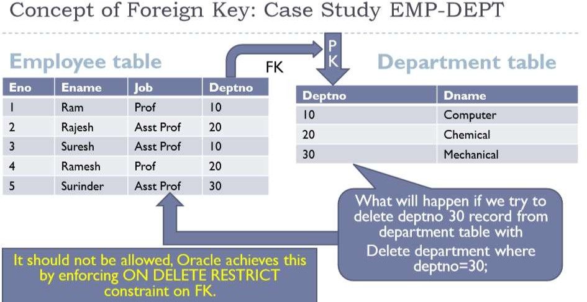

Slide 39
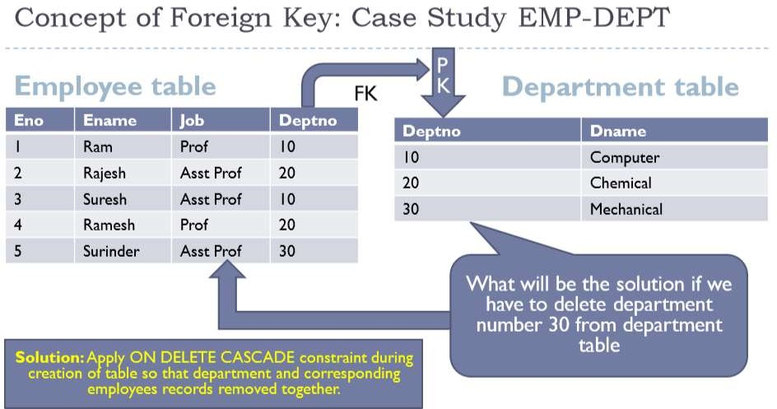

Slide 40
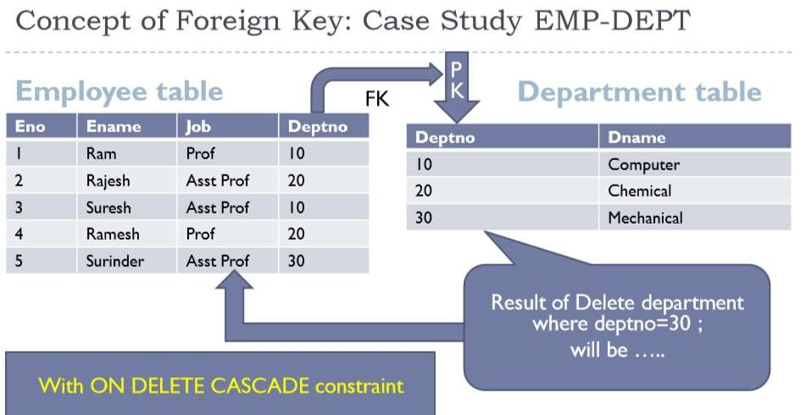

Slide 41
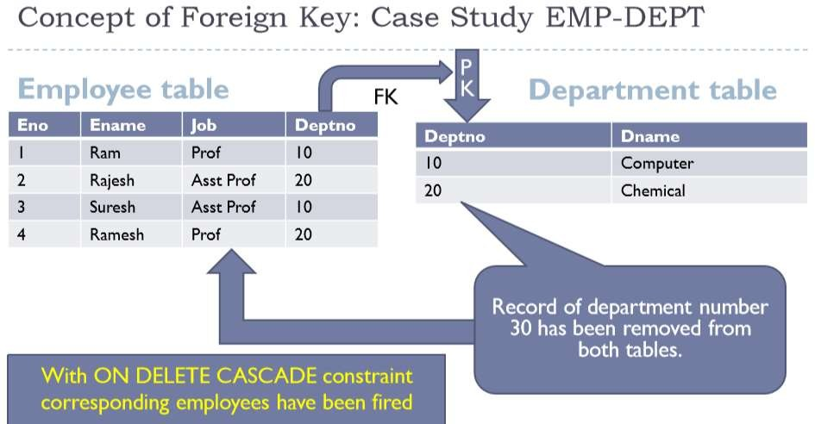

Slide 42
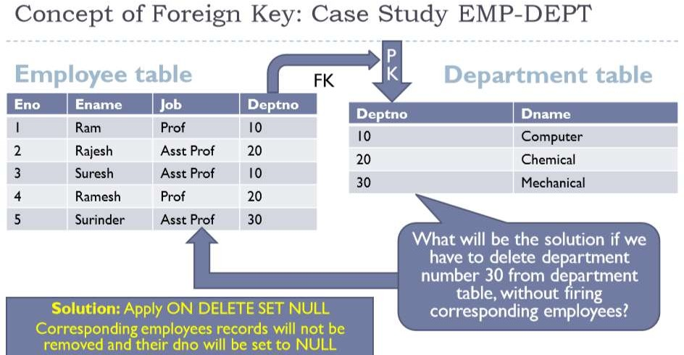

Slide 43
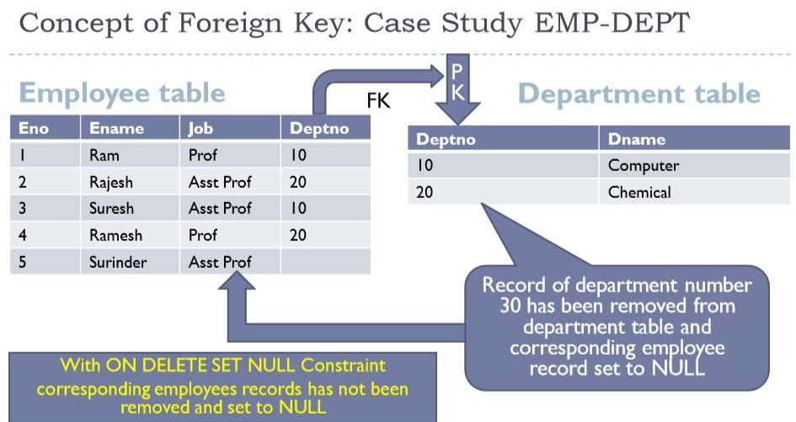

Slide 44
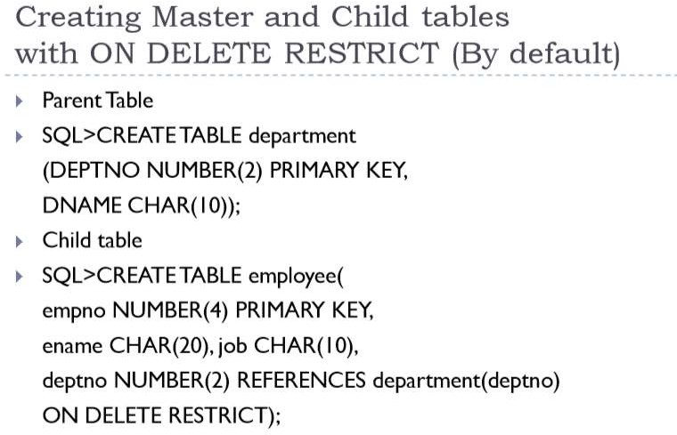

Slide 45
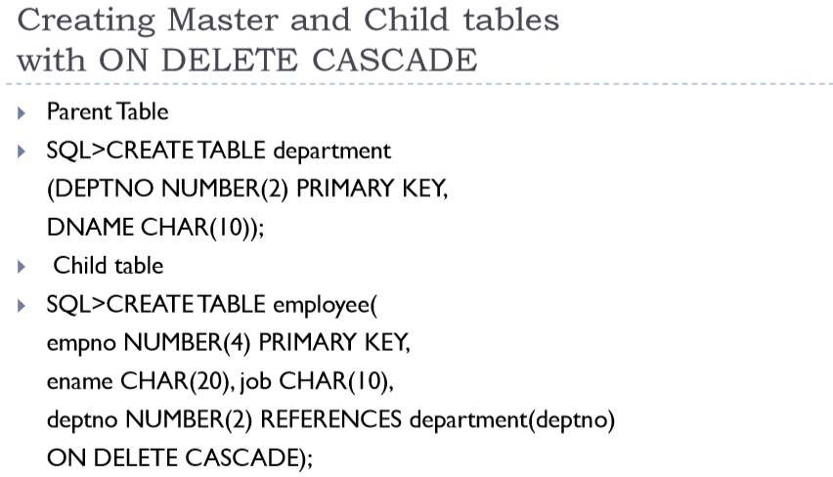

Slide 46
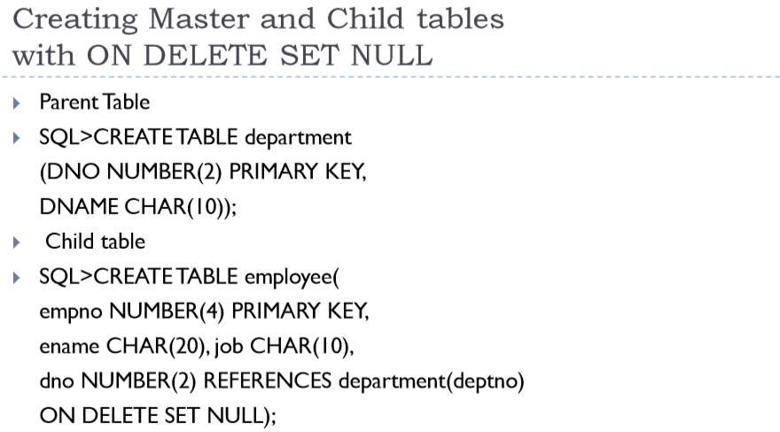

Slide 47
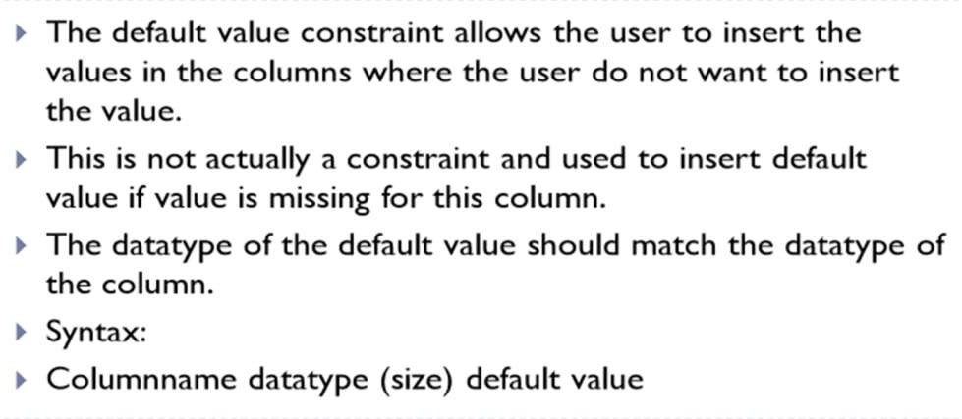
DEFAULT constraint
The DEFAULT constraint provides a default value to a column when the INSERT INTO statement does not provide a specific value.

Slide 48
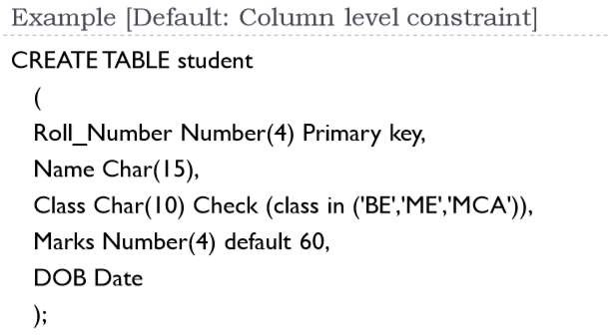

Slide 49
DEFAULT constraint
Example
For example, the following SQL creates a new table called CUSTOMERS and adds five columns.
Here, the SALARY column is set to 5000.00 by default, so in case the INSERT INTO statement does not provide a value for this column, then by default this column would be set to 5000.00.
CREATE TABLE CUSTOMERS( ID INT NOT NULL,
NAME VARCHAR (20) NOT NULL, AGE INT NOT NULL, ADDRESS CHAR (25) ,
SALARY DECIMAL (18, 2) DEFAULT 5000.00,
PRIMARY KEY (ID)
);

Slide 50
if the CUSTOMERS table has already been created, then to add a DEFAULT constraint to the SALARY column, you would write a query like the one which is shown in the code block below.
ALTER TABLE CUSTOMERS
MODIFY SALARY DECIMAL (18, 2) DEFAULT 5000.00;
Drop Default Constraint
To drop a DEFAULT constraint, use the following SQL query.
ALTER TABLE CUSTOMERS
ALTER COLUMN SALARY DROP DEFAULT;

Slide 51
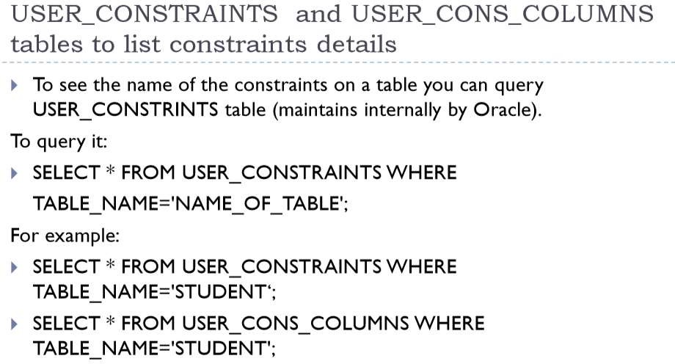

Slide 52
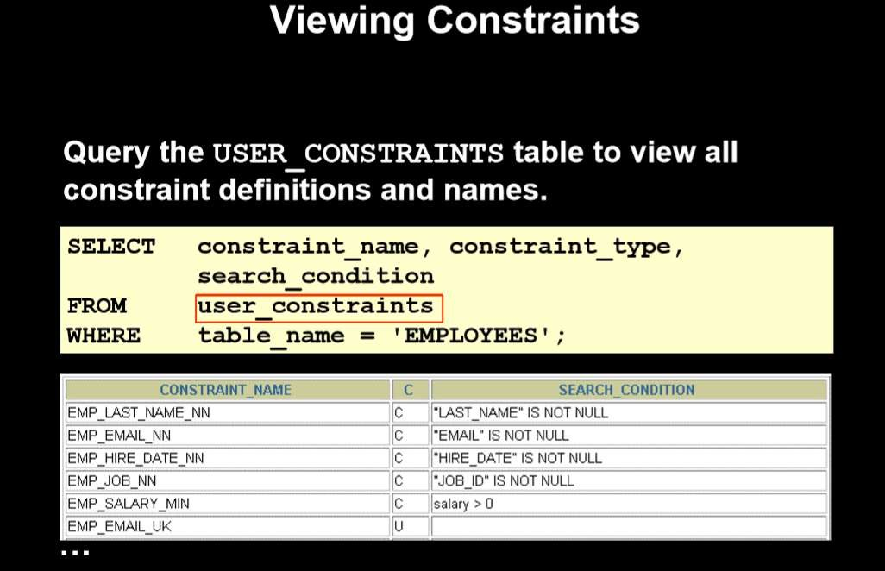

Slide 53
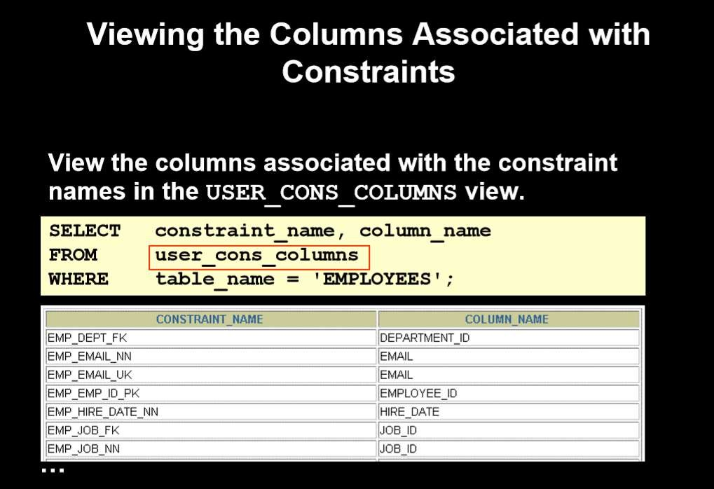

Slide 54
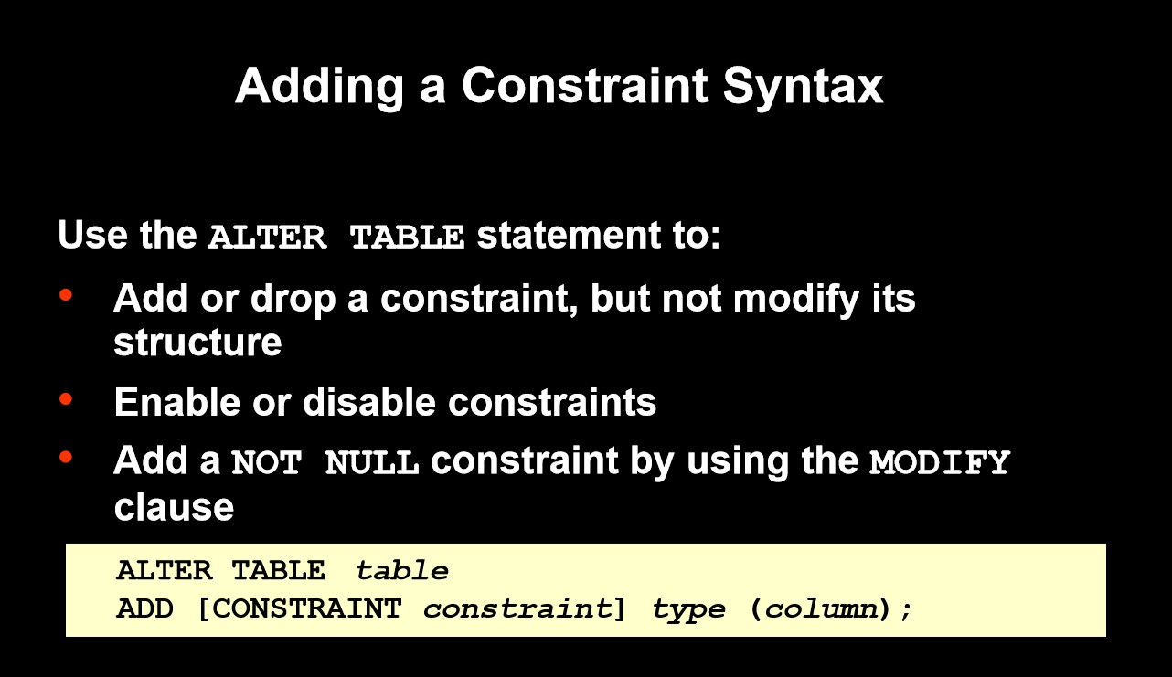

Slide 55
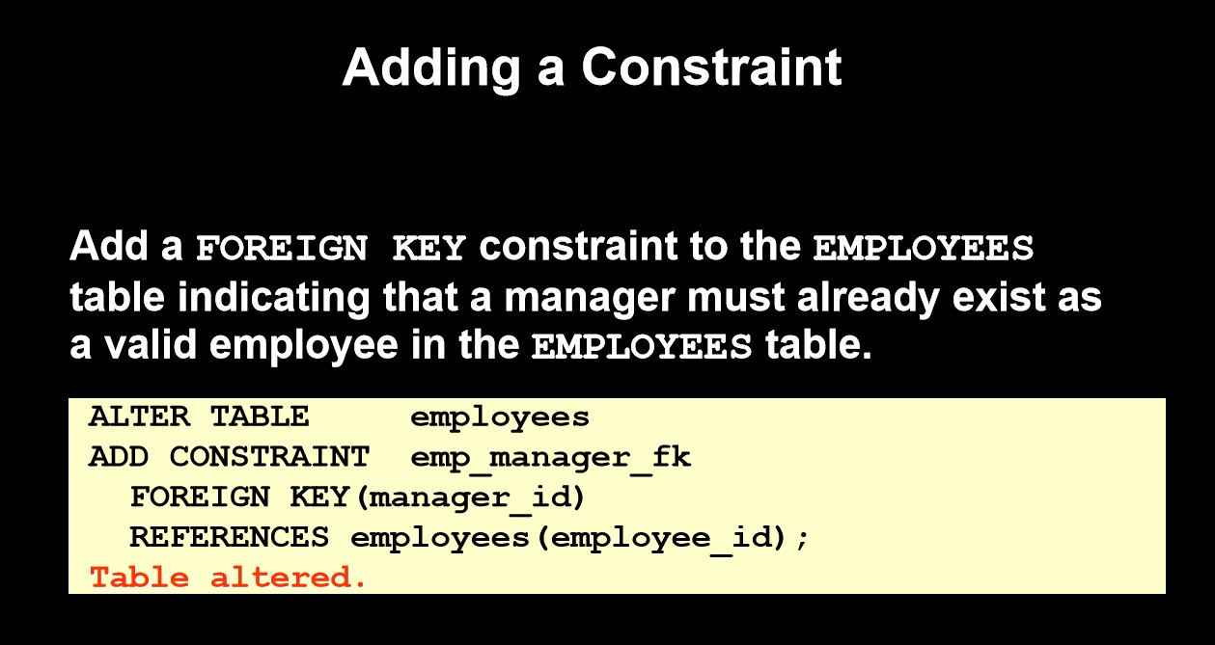

Slide 56
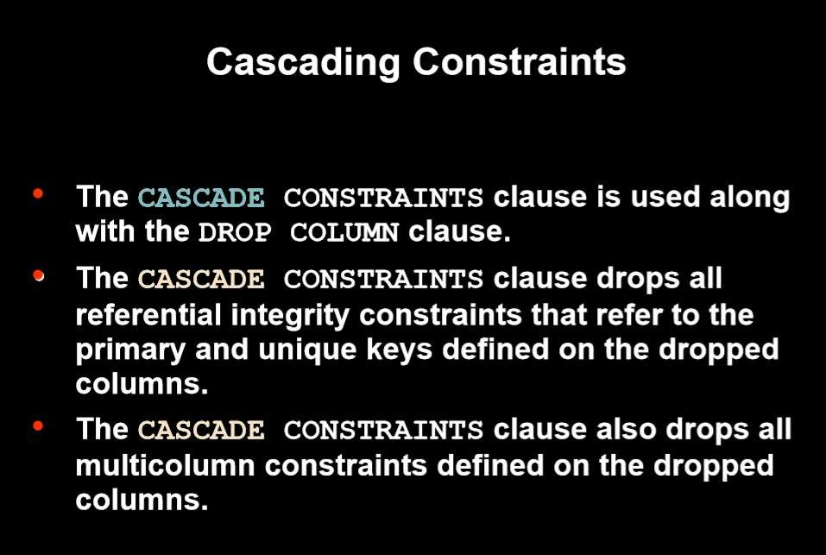

Slide 57
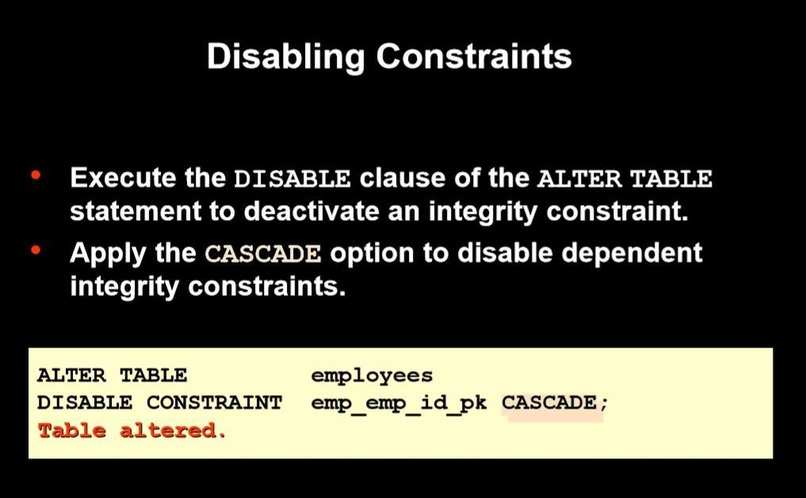

Slide 58
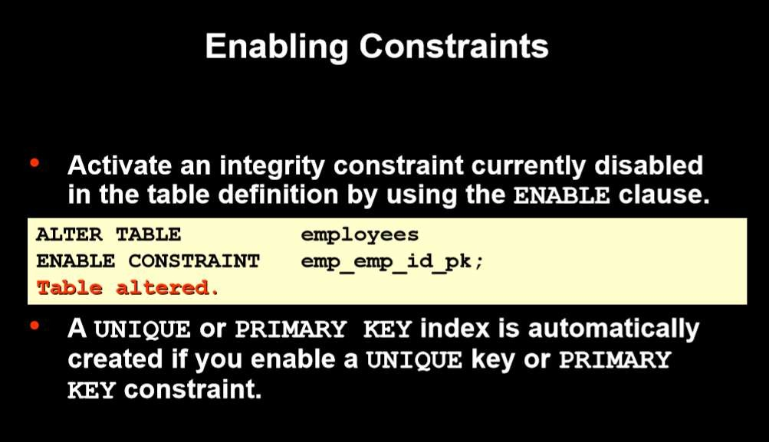

Slide 59
Thank You

